Slide 1
German Credit Data
By
Amulya

Slide 2
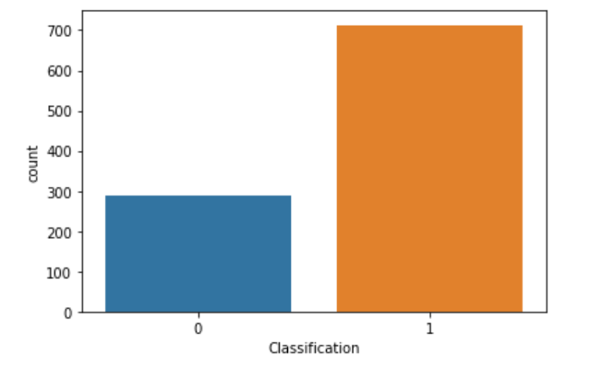
Count of Good and Bad risk

Slide 3
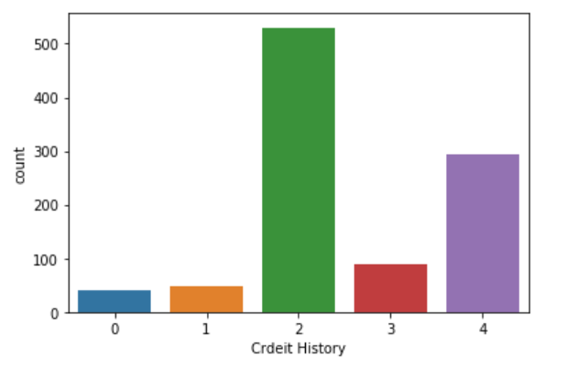
Distribution of Credit History

Slide 4
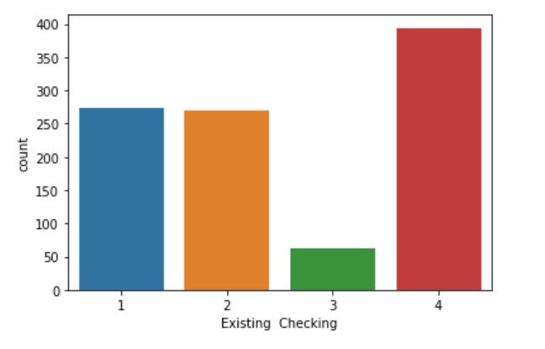
Count plot of Existing checking account

Slide 5
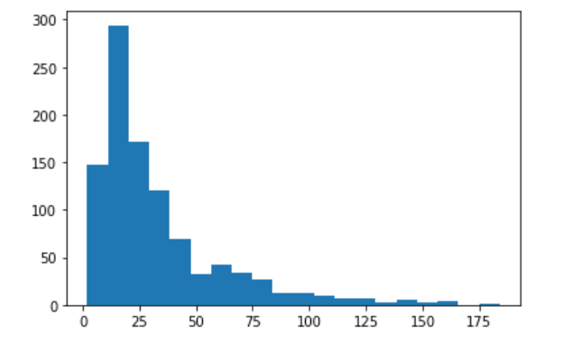
Distribution of Credit Amount

Slide 6
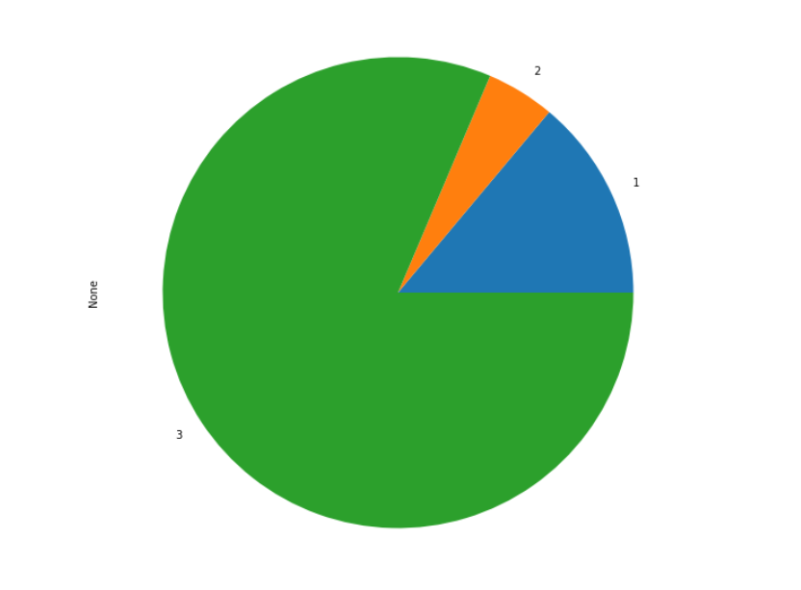
Other Instalment plans

Slide 7
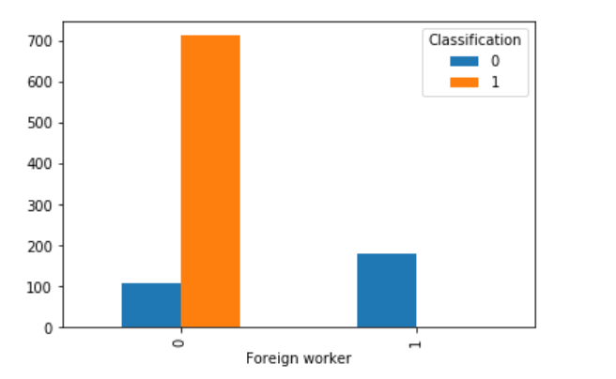
Foreign Worker vs Classification

Slide 8
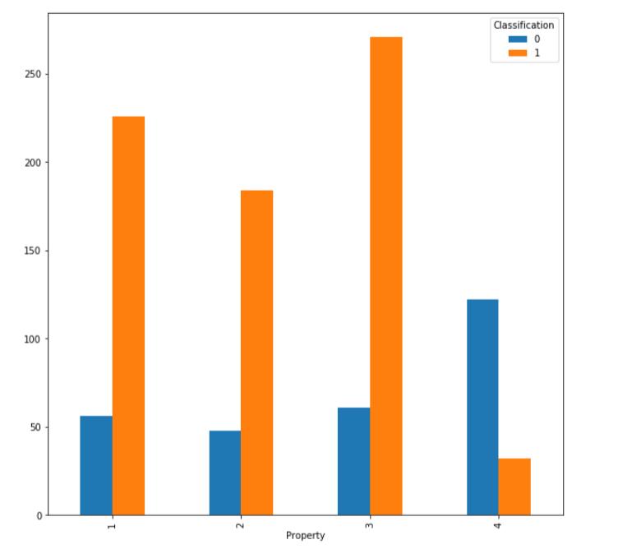
Property vs Classification

Slide 9
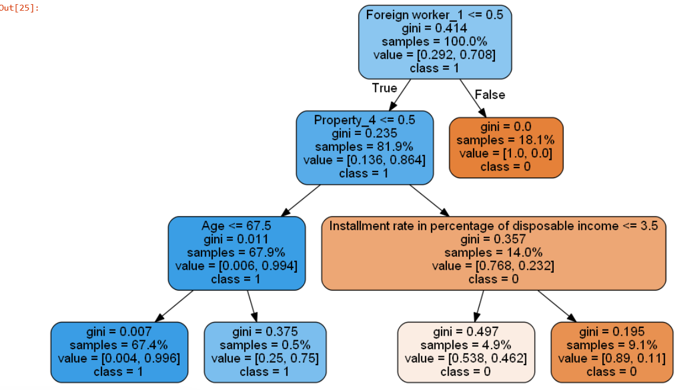
Decision Tree Model

Slide 10
Models
Decision Tree Model:
Accuracy: 98.85%
Ensemble Model:
Accuracy: 98.5%
Random Forests:
Accuracy: 97%

Slide 11
Boosting Models
Gradient Boosting:
Accuracy:97%
XgBoost:
Accuracy:99.74%

Slide 12
Thank You

